Slide 1
Lecture 8
Runge-Kutta RK4 Methods

Slide 2
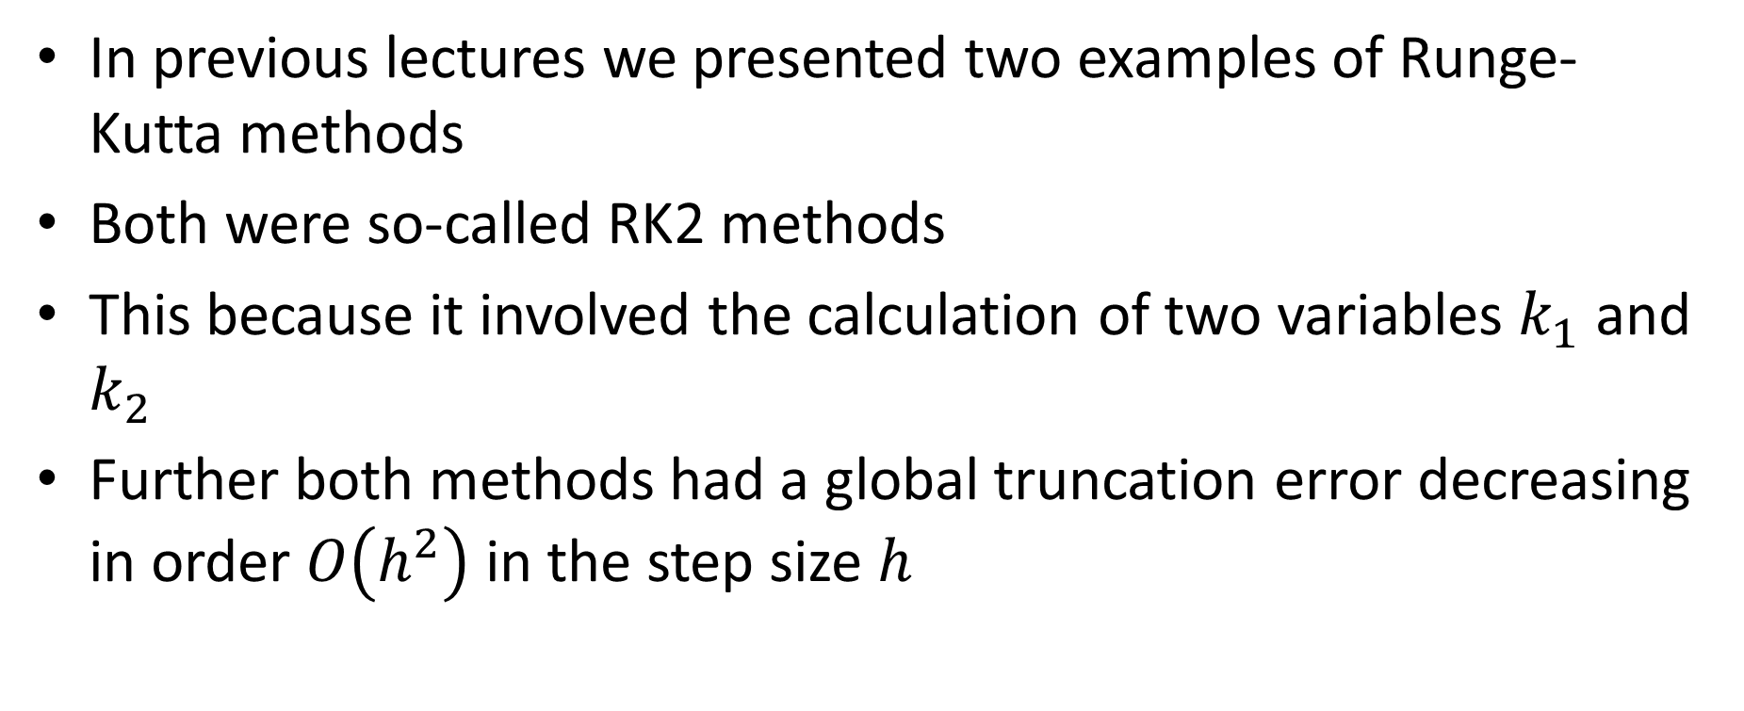
Introduction
In previous lectures we presented two examples of Runge-Kutta methods
Both were so-called RK2 methods
This because it involved the calculation of two variables $k_{1}$ and $k_{2}$
Further both methods had a global truncation error decreasing in order $O\left(h^{2}\right)$ in the step size $h$
Notes:
In previous lectures we presented two examples of Runge-Kutta methods
Both were examples of so-called RK2 methods
This terminology comes from the fact it involved the calculation of two variables $k_{1}$ and $k_{2}$
Further both methods had a global truncation error decreasing in order $O\left(h^{2}\right)$ in the step size $h$
The link between the number of variables ki and the order of the global truncation error is not an accident for the RK2 methods as we will see in this lecture

Slide 3
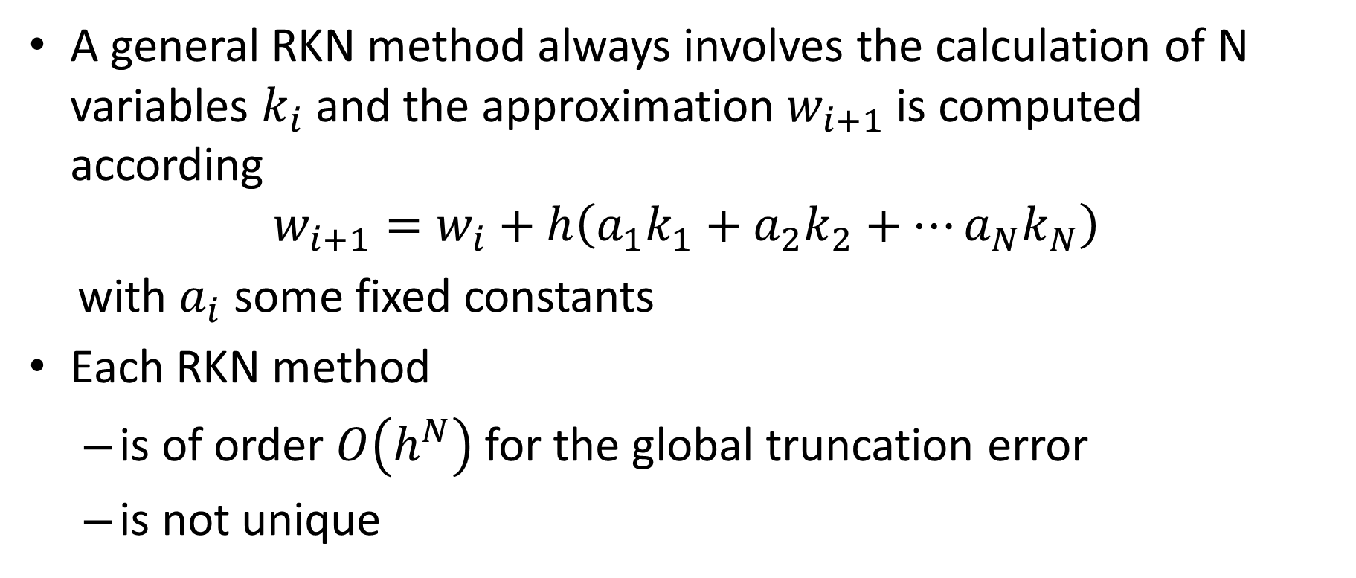
General RKN methods
A general RKN method always involves the calculation of N variables $k_{i}$ and the approximation $w_{i+1}$ is computed according
$$w_{i+1}=w_{i}+h\left(a_{1}k_{1}+a_{2}k_{2}+⋯a_{N}k_{N}\right)$$
with $a_{i}$ some fixed constants
Each RKN method
is of order $O\left(h^{N}\right)$ for the global truncation error
is not unique
Notes:
A general RKN method always involves the calculation of N variables $k_{i}$ and the approximation $w_{i+1}$ is computed according
$$w_{i+1}=w_{i}+h\left(a_{1}k_{1}+a_{2}k_{2}+⋯a_{N}k_{N}\right)$$
with $a_{i}$ some fixed constants
There are two rules that are valid for RKN methods
Each RKN method
is of order $O\left(h^{N}\right)$ for the global truncation error
And RKN methods are not unique
We saw this in the previous lectures were we discussed two examples of RK2 methods
In fact for a given N, there exist an infinite number of RKN methods

Slide 4
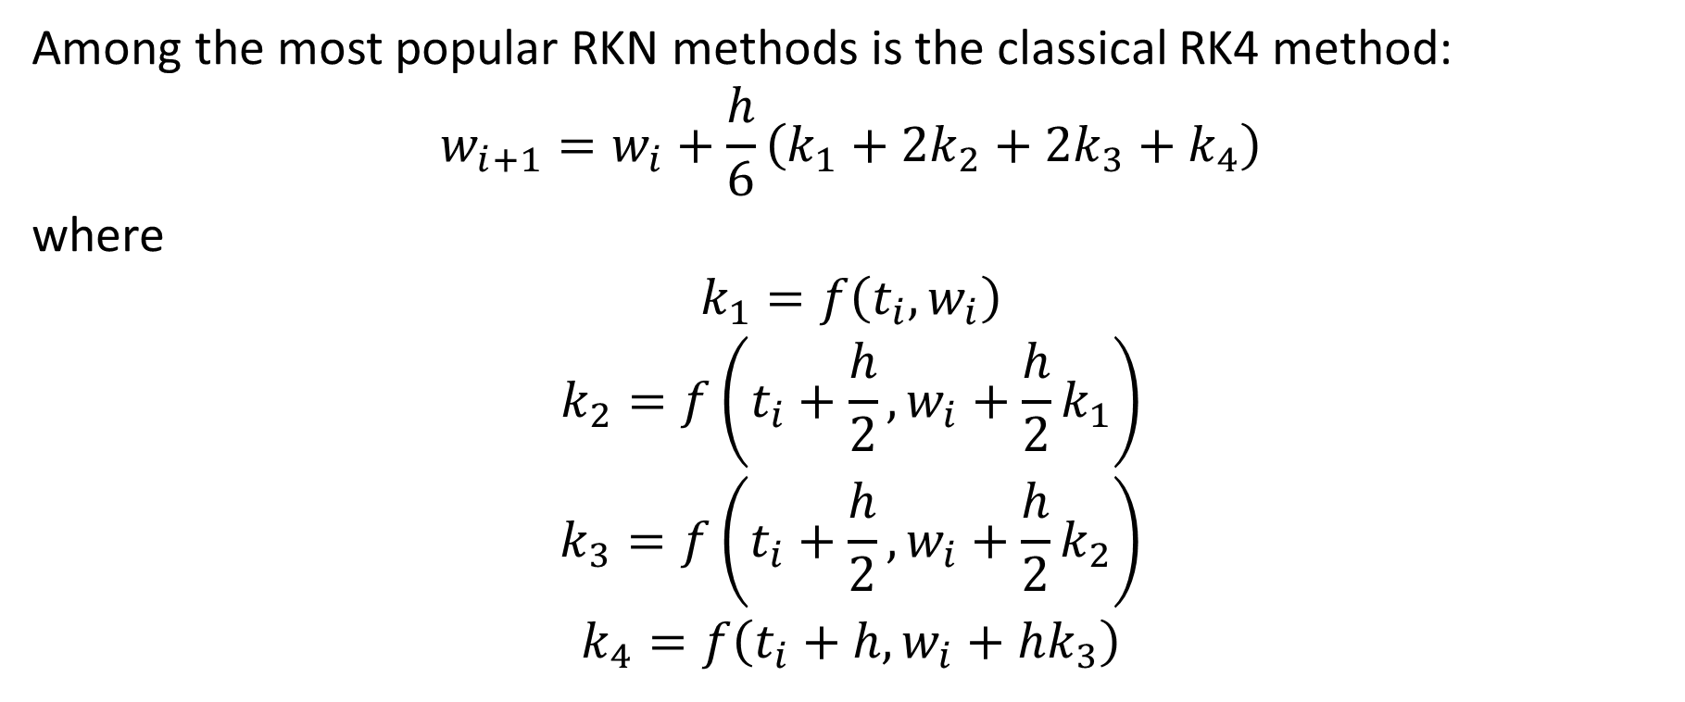
Classical RK4 method
Among the most popular RKN methods is the classical RK4 method:
$$w_{i+1}=w_{i}+\frac{h}{6}\left(k_{1}+2k_{2}+2k_{3}+k_{4}\right)$$
where
$$k_{1}=f\left(t_{i},w_{i}\right)$$
$$k_{2}=f\left(t_{i}+\frac{h}{2},w_{i}+\frac{h}{2}k_{1}\right)$$
$$k_{3}=f\left(t_{i}+\frac{h}{2},w_{i}+\frac{h}{2}k_{2}\right)$$
$$k_{4}=f\left(t_{i}+h,w_{i}+hk_{3}\right)$$
Notes:
Among the most popular RKN methods is the classical RK4 method
This methods writes $w_{i+1}=w_{i}+\frac{h}{6}\left(k_{1}+2k_{2}+2k_{3}+k_{4}\right)$
It involves for variables ki which are defined as displayed on the slide
This method is in order 4 for the global truncation error

Slide 5

Example
We want to solve
$$\left\{\begin{aligned}\frac{dy}{dt}=ty+t^{3} \\ y\left(0\right)=1\end{aligned}\right.$$
with the classical Runge-Kutta RK4 method
Notes:
Let us apply the RK4 method to a sample problem
We consider the initial value problem $\frac{dy}{dt}=ty+t^{3}$ with initial condition y(0)=1

Slide 6
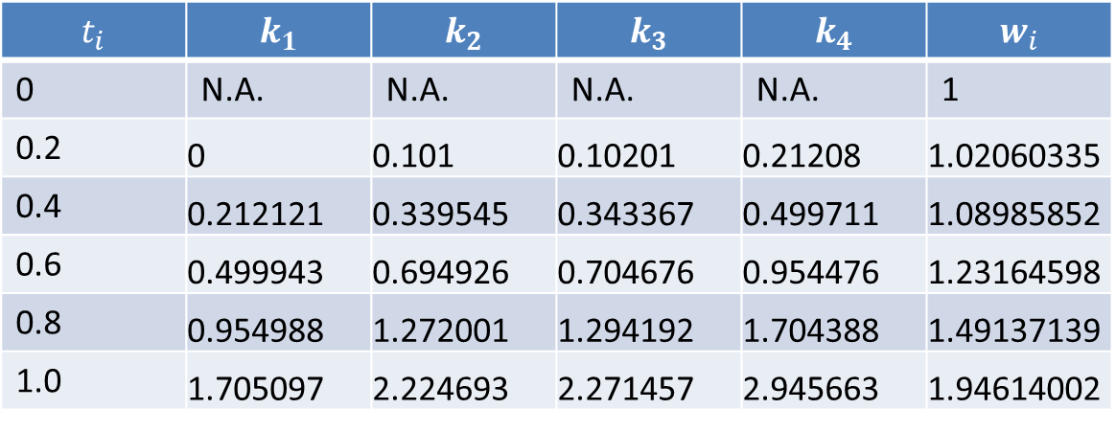
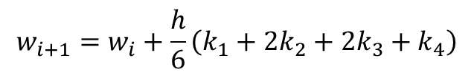



Example
We organize the calculations in a table
$$\left\{\begin{aligned}\frac{dy}{dt}=ty+t^{3} \\ y\left(0\right)=1\end{aligned}\right.$$
$$t_{i}$$ | $$k_{1}$$ | $$k_{2}$$ | $$k_{3}$$ | $$k_{4}$$ | $$w_{i}$$
0 | N.A. | N.A. | N.A. | N.A. | 1
0.2 | 0 | 0.101 | 0.10201 | 0.21208 | 1.02060335
0.4 | 0.212121 | 0.339545 | 0.343367 | 0.499711 | 1.08985852
0.6 | 0.499943 | 0.694926 | 0.704676 | 0.954476 | 1.23164598
0.8 | 0.954988 | 1.272001 | 1.294192 | 1.704388 | 1.49137139
1.0 | 1.705097 | 2.224693 | 2.271457 | 2.945663 | 1.94614002
$$k_{1}=f\left(t_{i},w_{i}\right)$$
$$k_{2}=f\left(t_{i}+\frac{h}{2},w_{i}+\frac{h}{2}k_{1}\right)$$
$$k_{3}=f\left(t_{i}+\frac{h}{2},w_{i}+\frac{h}{2}k_{2}\right)$$
$$k_{4}=f\left(t_{i}+h,w_{i}+hk_{3}\right)$$
$$w_{i+1}=w_{i}+\frac{h}{6}\left(k_{1}+2k_{2}+2k_{3}+k_{4}\right)$$
Notes:
As always, organizing the calculations in a table is very useful
We present the calculations for the case one chooses h=0.2
At first we enter the initial condition.
At this point k1 to k4 are not defined, and not needed neither of course
To compute the approximation w1 in t1, in our example 0.2, one needs to compute k1 to k4 using the entries form the line above.
Once k1 to k4 are computed, one can then calculate w1
One proceeds like this for each ti until one reaches the desired tf, in our case 1

Slide 7
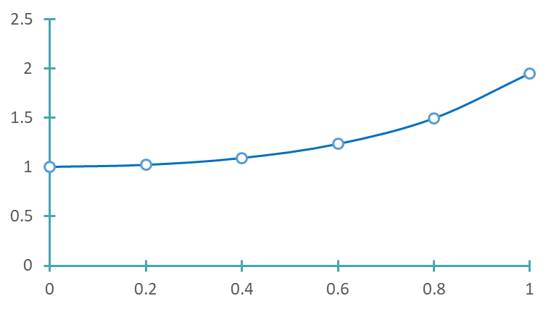



Example
$$y$$
$$y\left(t\right)={3e}^{t^{2}/2}−t^{2}−2$$
$$t$$
Notes:
The graph displays the computed approximations (the circles) together with the exact solution (the smooth line)
Note how precise the approximations are. No difference can be detected between the approximations and the exact solution on the graph

Slide 8
Octave Code
function [t, w] = RK4(f,to,yo,h,n)
w=[yo];
t=[to];
for i = 1:n
k1=f(t(end),w(end));
k2=f(t(end)+h/2,w(end)+k1*h/2);
k3=f(t(end)+h/2,w(end)+k2*h/2);
k4=f(t(end)+h,w(end)+k3*h);
w=[w w(end)+h/6*(k1+2*k2+2*k3+k4)];
t=[t t(end)+h];
endfor
endfunction
Notes:
We present here a possible implementation of the RK4 method in octave
We define a function RK4
This function will return two vectors.
The vector t will contain the various ti and the vector w will contain the various wi
The function takes 4 arguments
The first one is the function f defining the ODE
The second one is the time to of the initial condition
The third is the corresponding initial value yo
The next argument is the step size h and the last argument is the number n of steps we want to perform
The function start by initializing the vectors w and t by filling them with the initial condition
These two vectors will then progressively be filled further with the calculated values ti and wi
We do this with a for loop running from 1 to n
Inside the loop we calculate the values k1 to k4 as well as wi which we add to the vector w
Note the keyword “end”. This keyword automatically sects the last entry of a vector
We compute as well the time steps ti and add them to the vector t
We close the for loop with the key word endfor and we close the function with the keyword endfunction

Slide 9
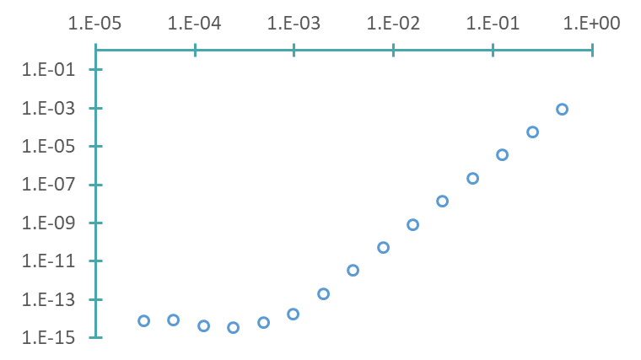
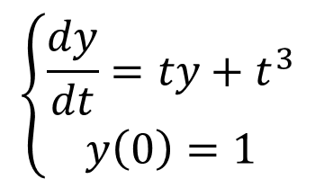





Convergence
$$h$$
$$\left\{\begin{aligned}\frac{dy}{dt}=ty+t^{3} \\ y\left(0\right)=1\end{aligned}\right.$$
$$E=O(h^{4})$$
$${E≅0.015h}^{4.0078}$$
True Error$E$ in $t=1$
Truncation errors
$$y\left(t\right)={3e}^{t^{2}/2}−t^{2}−2$$
Round-off errors
Notes:
The plot on the slide displays the true error in t=1 in function of various step sizes
The true error is computed by taking the difference, in absolute value, between the true solution in t=1 and the numerical approximation in t=1 calculated by the RK4 solver.
This error is the global truncation error.
I invite you to try to reproduce these graphs with the help of the octave script we presented to implement the RK4 solver
We can identify two different regions on the graph
For larger values of h, we observe a decrease of the error
This is the region dominated by the truncation error
For small values of h, we observe no further decrease in the error
This region is dominated by the round-off errors
We can use a power law to fit the error plot in the region dominated by the truncation error
The fitted power law suggests that the error decreases in forth order in h
This is indeed the case. The RK4 solver is in forth order in the step size h for the global truncation error.

Slide 10
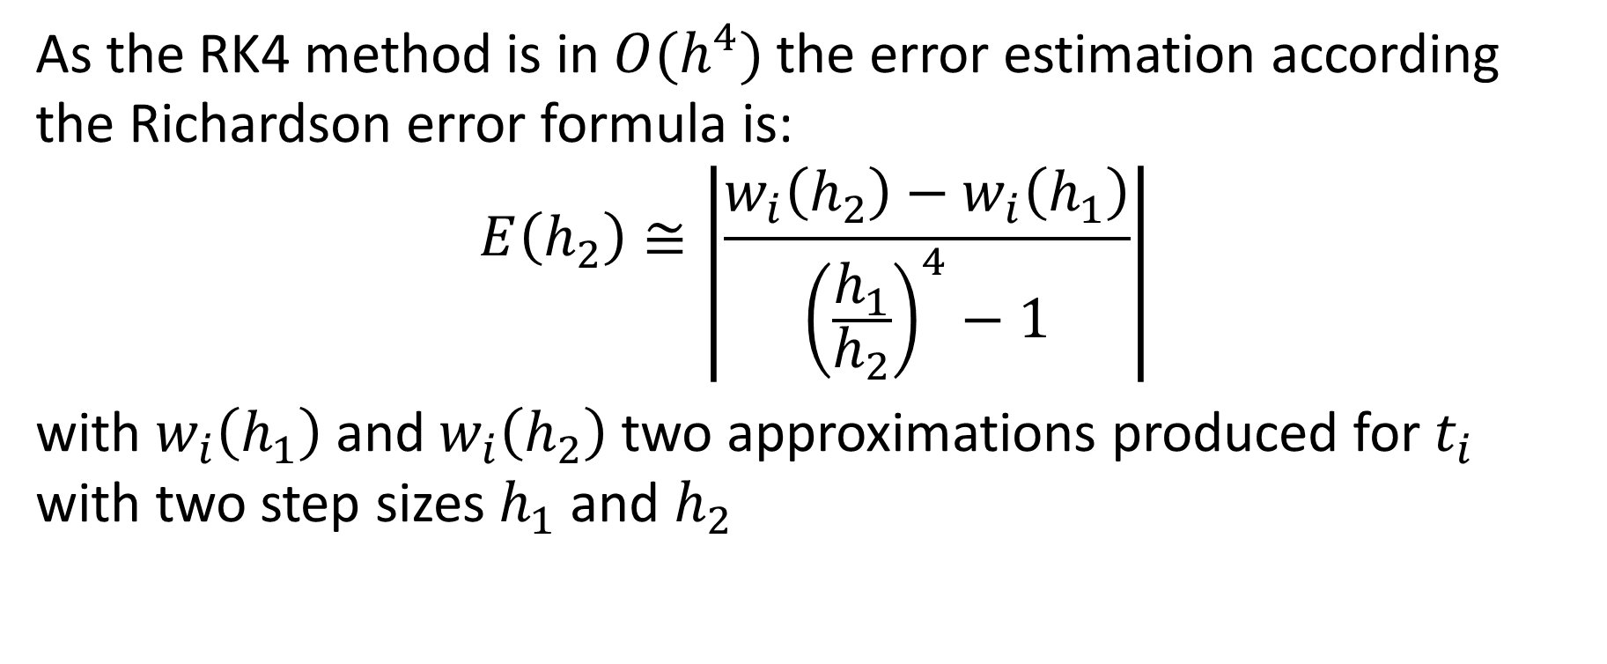
Estimating Truncation Error
As the RK4 method is in $O(h^{4})$the error estimation according the Richardson error formula is:
$$E\left(h_{2}\right)≅\left|\frac{w_{i}\left(h_{2}\right)−w_{i}\left(h_{1}\right)}{{\left(\frac{h_{1}}{h_{2}}\right)}^{4}−1}\right|$$
with $w_{i}\left(h_{1}\right)$ and $w_{i}\left(h_{2}\right)$ two approximations produced for $t_{i}$ with two step sizes $h_{1}$ and $h_{2}$
Notes:
As the RK4 method is in $O(h^{4})$, we can use the Richardson error formula to estimate the truncation error.
The error estimation according the Richardson error formula is:
$$E\left(h_{2}\right)≅\left|\frac{w_{i}\left(h_{2}\right)−w_{i}\left(h_{1}\right)}{{\left(\frac{h_{1}}{h_{2}}\right)}^{4}−1}\right|$$
with $w_{i}\left(h_{1}\right)$ and $w_{i}\left(h_{2}\right)$ two approximations produced for $t_{i}$ with two step sizes $h_{1}$ and $h_{2}$

Slide 11
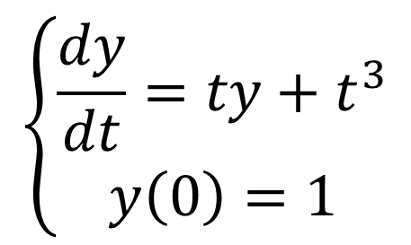

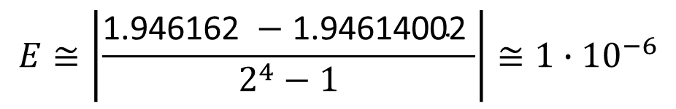
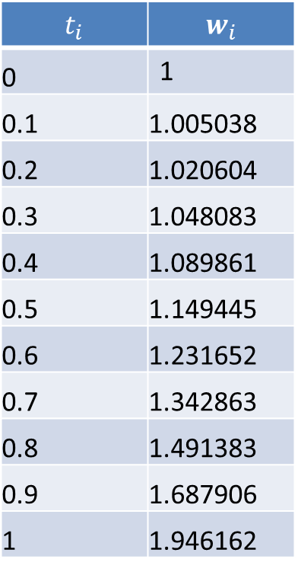
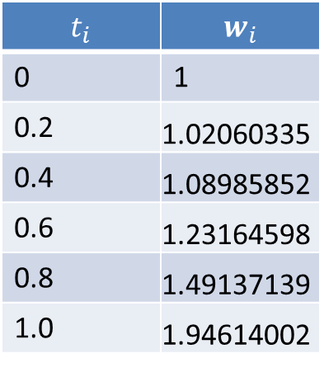
Example
$$t_{i}$$ | $$w_{i}$$
0 | 1
0.2 | 1.02060335
0.4 | 1.08985852
0.6 | 1.23164598
0.8 | 1.49137139
1.0 | 1.94614002
$$t_{i}$$ | $$w_{i}$$
0 | 1
0.1 | 1.005038
0.2 | 1.020604
0.3 | 1.048083
0.4 | 1.089861
0.5 | 1.149445
0.6 | 1.231652
0.7 | 1.342863
0.8 | 1.491383
0.9 | 1.687906
1 | 1.946162
$$\left\{\begin{aligned}\frac{dy}{dt}=ty+t^{3} \\ y\left(0\right)=1\end{aligned}\right.$$
$$E≅\left|\frac{\text{1.946162 }−\text{1.94614002 }}{2^{4}−1}\right|≅1∙{10}^{−6}$$
$$y(1)≅\text{1.94616}±0.000001$$
Notes:
Let us verify the validity of the Richardson error formula with an example
The two tables displayed list numerical solutions computed by the RK4 solver for the initial value problem $\frac{dy}{dt}=ty+t^{3}$ with initial condition y(0)=1.
The first table was produced using the step size h1=0.2 whereas the second one was computed with the step size h2=0.1
We can now estimated the truncation error for the approximation in t=1
For this we apply Richardson's error formula using the two approximations in t=1 which results in about ${10}^{−6}$
Consequently we can say that $y(1)≅\text{1.94616}±0.000001$
I invite you to compare this estimation with the true value in t=1. You will realize that the error estimation is perfectly valid

Slide 12

Illustration
We want to solve
$$\left\{\begin{aligned}\frac{dy}{dt}=−4t^{3}y^{2} \\ y\left(−10\right)=1/10001\end{aligned}\right.$$
with the various RKN methods
Exact solution: $y\left(t\right)=\frac{1}{t^{4}+1}$
Notes:
To end this lecture, let us make a short illustration where we solve a same initial value problem with different IVP solvers
We consider the initial value problem $\frac{dy}{dt}=−4t^{3}y^{2}$ with the initial condition $y\left(−10\right)=1/10001$
You can verify that the exact solution of this IVP is $y\left(t\right)=\frac{1}{t^{4}+1}$

Slide 13
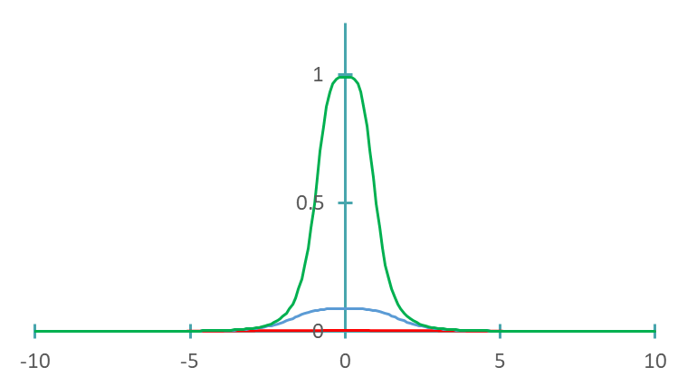

Illustration
RK4
$$h=0.1$$
RK2 (Midpoint)
RK1 (Euler)
Notes:
The graph displays the approximations produced by various Runge-Kutta methods.
All solvers were run with a same step size of 0.1
The RK1 method (Euler’s method in the present case) gives a very poor approximation
The RK2 method (Midpoint method in our example) gives a slightly better approximation, but still very poor
The RK4 method (the classical method presented in this lecture) gives on the contrary an excellent approximation. In fact, if we would add the exact solution on this graph we wouldn’t be able to distinguish any difference
This illustration demonstrates the importance of having high order methods

Slide 14
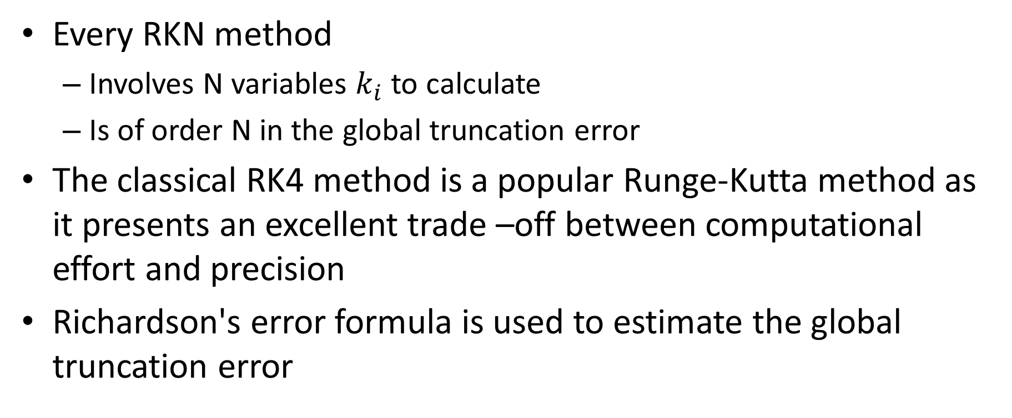
Summary
Every RKN method
Involves N variables $k_{i}$ to calculate
Is of order N in the global truncation error
The classical RK4 method is a popular Runge-Kutta method as it presents an excellent trade –off between computational effort and precision
Richardson's error formula is used to estimate the global truncation error
Notes:
Let us summarize the key findings
Every RKN method:
- Involves N variables $k_{i}$ to calculate
- Is of order N in the global truncation error
The classical RK4 method is a popular Runge-Kutta method as it presents an excellent trade –off between computational effort and precision
Richardson's error formula is used to estimate the global truncation error

